Slide 1
Game Engine Archetecture
Milestone 1

Slide 2
Table of contents
01
02
03
04
Game Theme
Design of game scene
Basic 3D scene
Mockup of game scene created in blender
Basic scene implemented in engine
Performance metrics
The memory useage, processing power usage and fps of the scene

Slide 3
01
Game theme
Pirates! 🏴‍☠️🦜

Slide 4
02
Scene design
Quick mockup Scene design made in blender

Slide 5
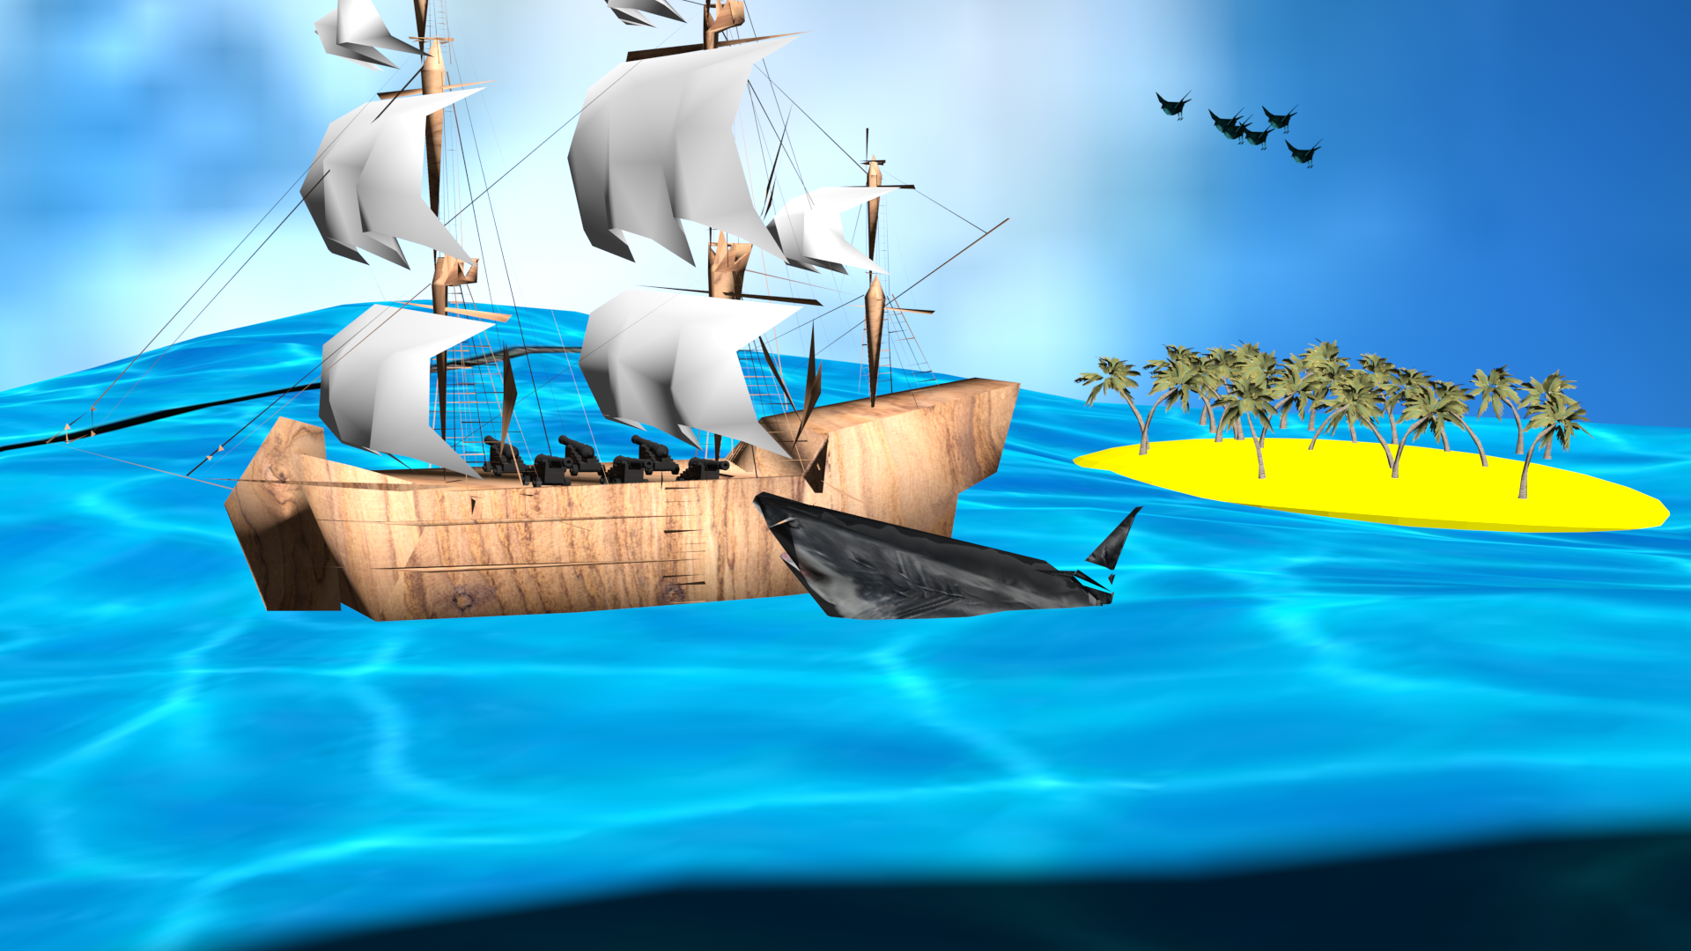
Scene design
In the game the player will be on a boat out at sea. A shark will be in the water overboard and will randomly pop up either side of the ship. The player must click or run into a cannon on the correct side of the ship to damage and defeat the shark.
The game will have a ps1 artstyle. For performance and personal interest reasons
Birds
The boat the player will be on
Trees
Cannons on the ship
The shark the player will fight

Slide 6
03
Current level
The scene rendered in the game engine as of now

Slide 7
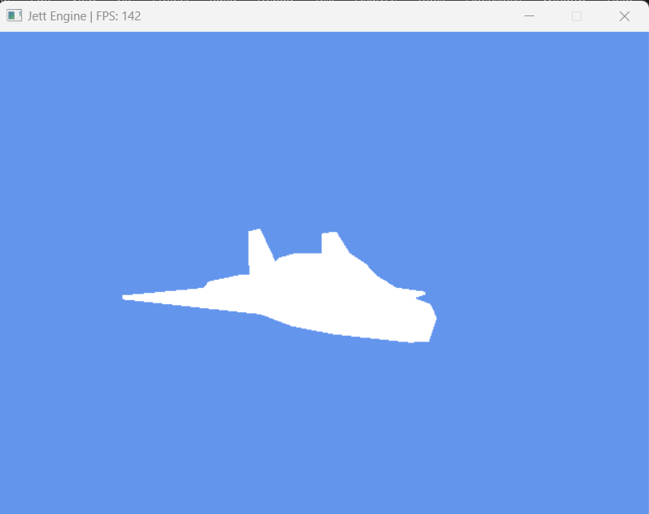
Current Level
So far the engine can load an obj model and render it using the render pipeline.
The update function spins the model around.

Slide 8
04
Performance
How does the engine perform so far

Slide 9
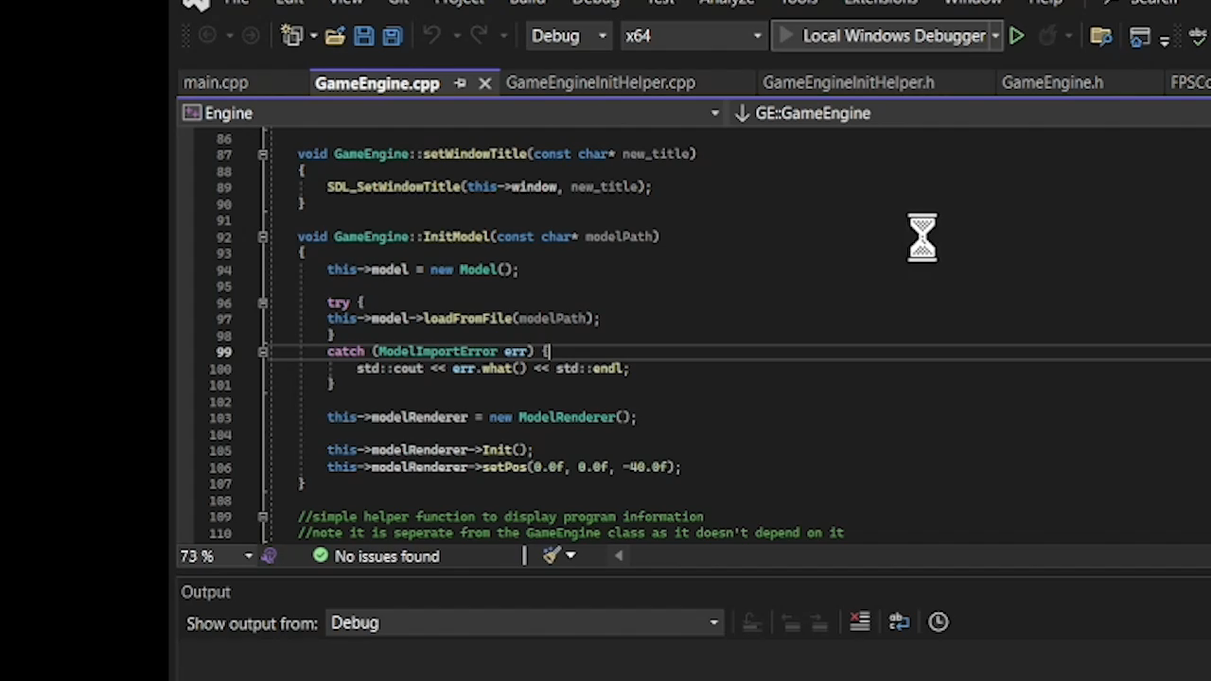
Performance FPS
With V sync on the engine runs at around 144 fps. Or around 130 when screen recording with obs.

Slide 10
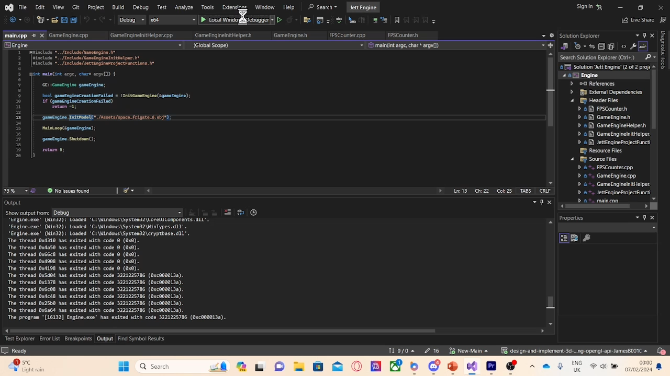
Performance Memory
The engine uses 68mb of memory when first opens.
After doing all its allocations (after about 9 seconds) it uses a stable 45mb of memory
No memory leeks YAY!

Slide 11
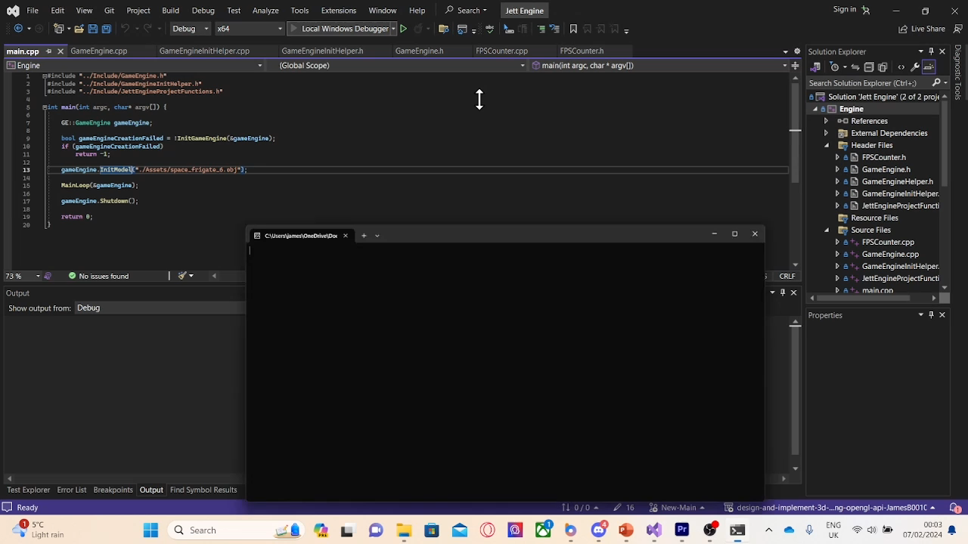
Performance CPU Usage
When initialising the Cpu usage peaks at 4%. After initialising the engine the processor usage runs at a steady 0 – 1%

Slide 12
05
Planned features
Planned features from the mark scheme

Slide 13
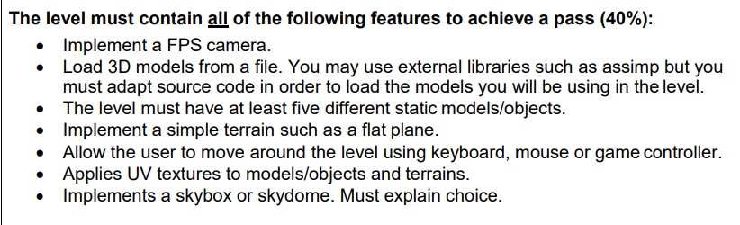
Planned mark scheme points

Slide 14
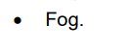
Planned mark scheme points
Or

Slide 15
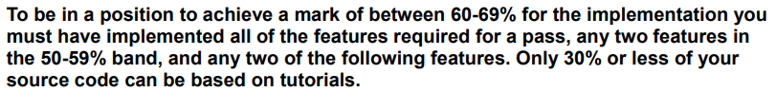
Planned mark scheme points

Slide 16
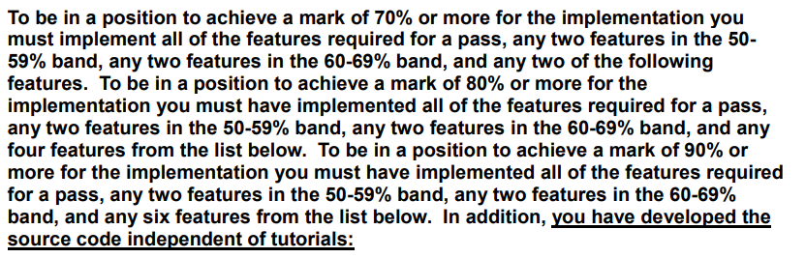
Planned mark scheme points

